Slide 1
DOCKERS
YASMEEN

Slide 2
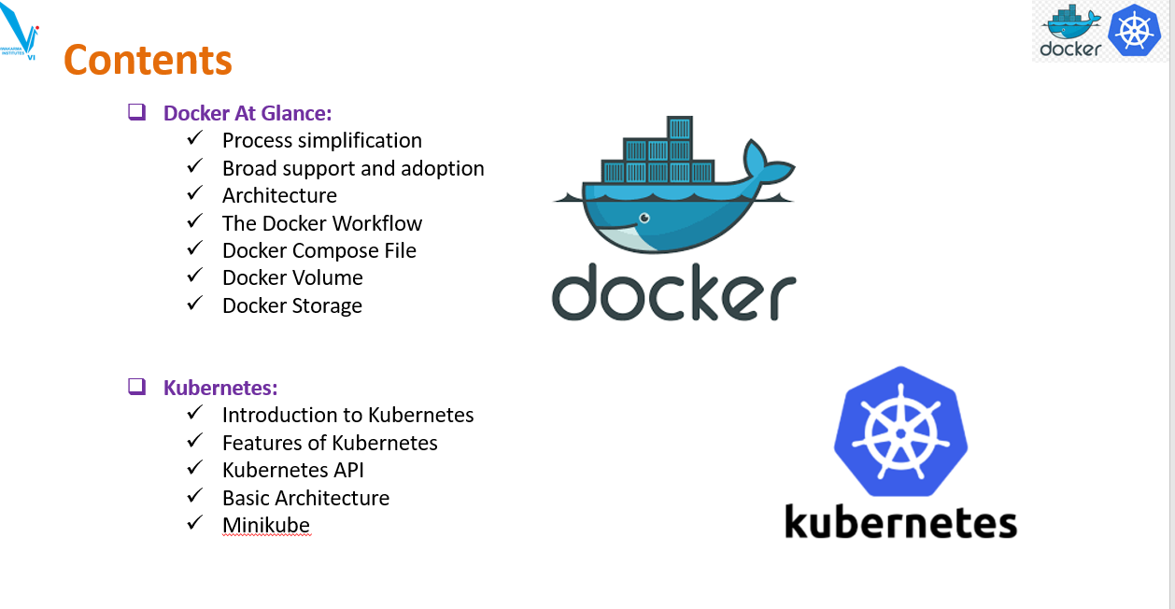

Slide 3
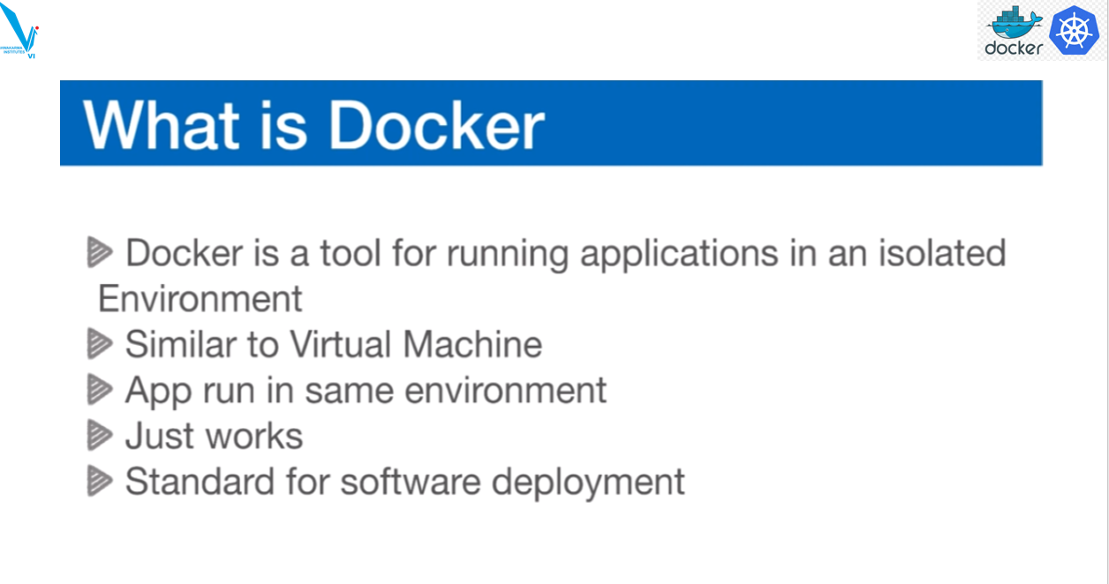

Slide 4
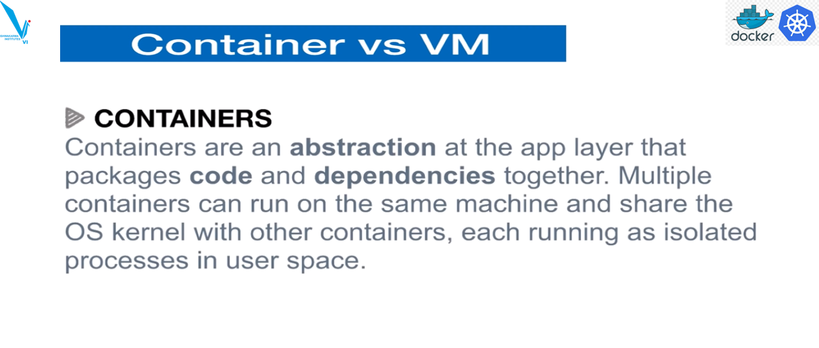

Slide 5
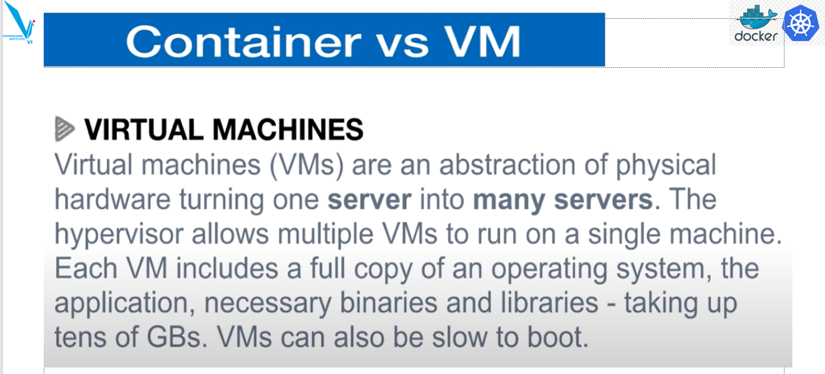

Slide 6
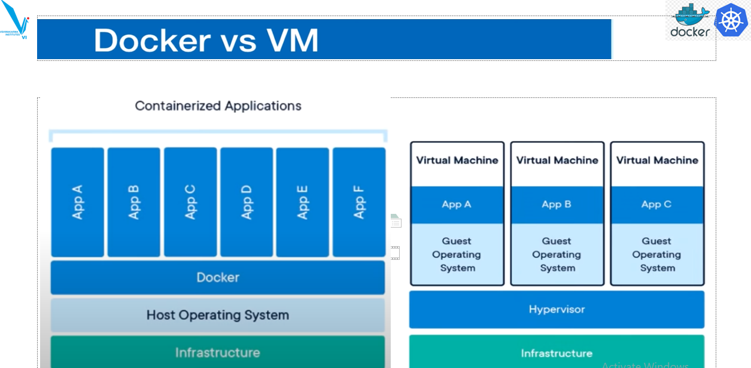

Slide 7
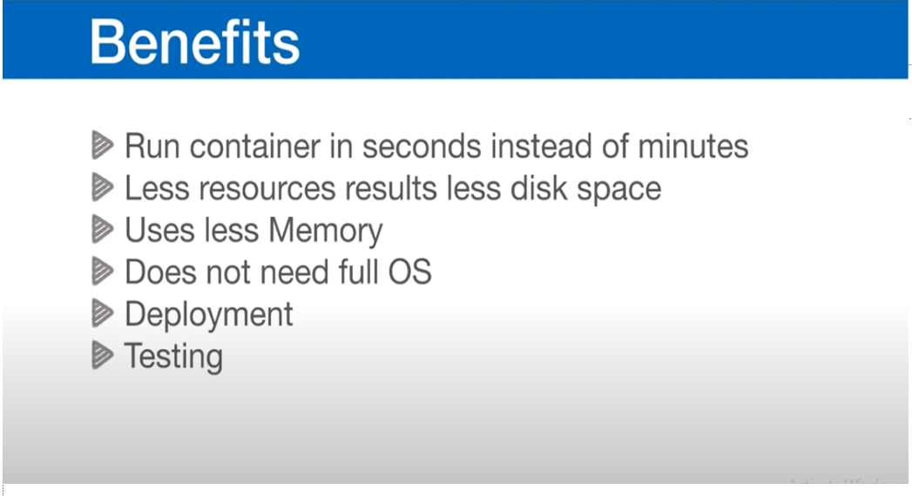

Slide 8
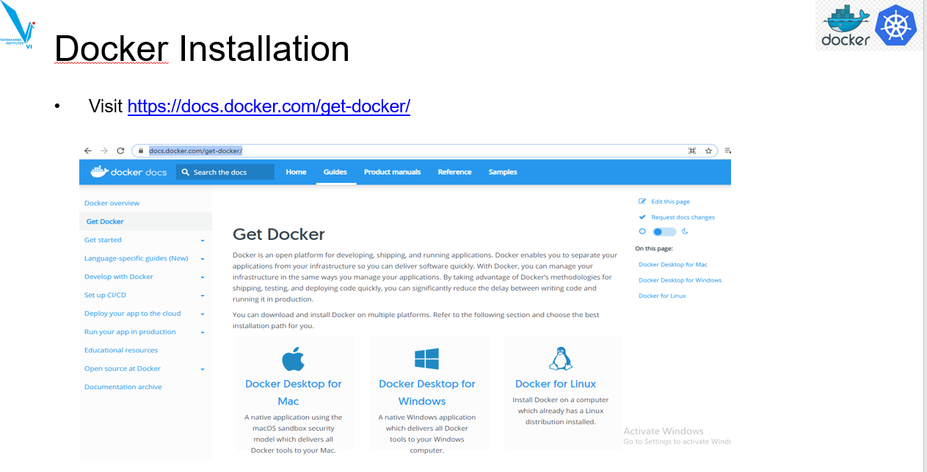

Slide 9
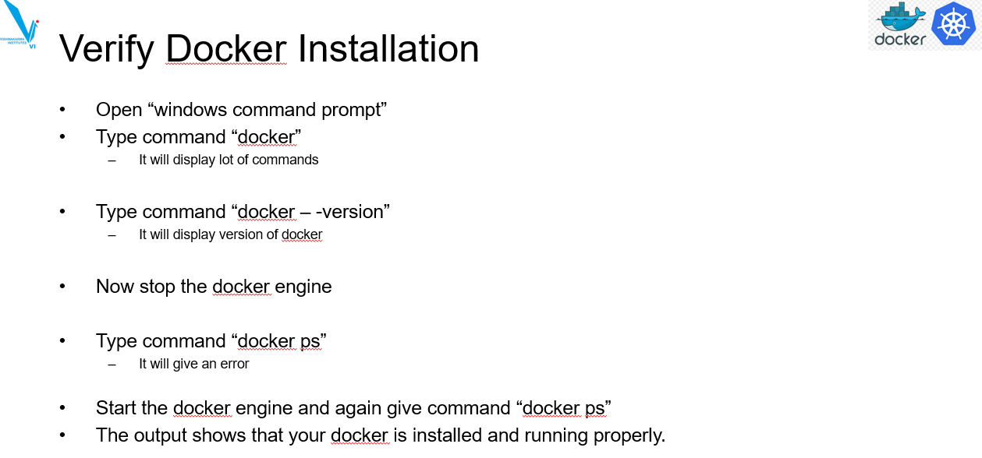

Slide 10
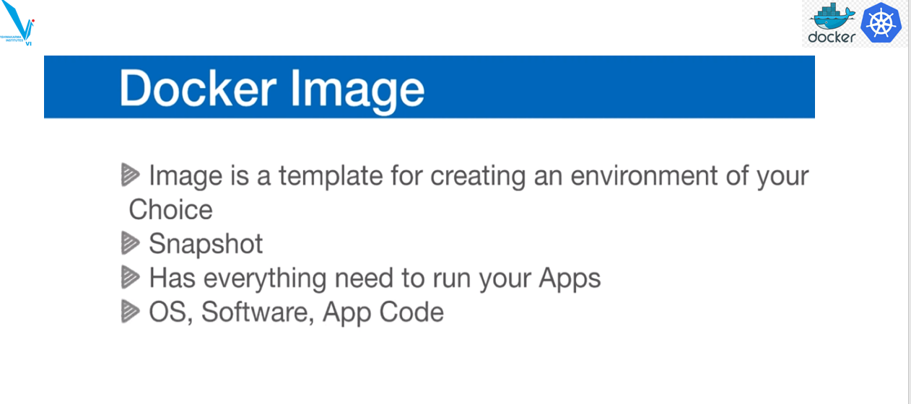

Slide 11
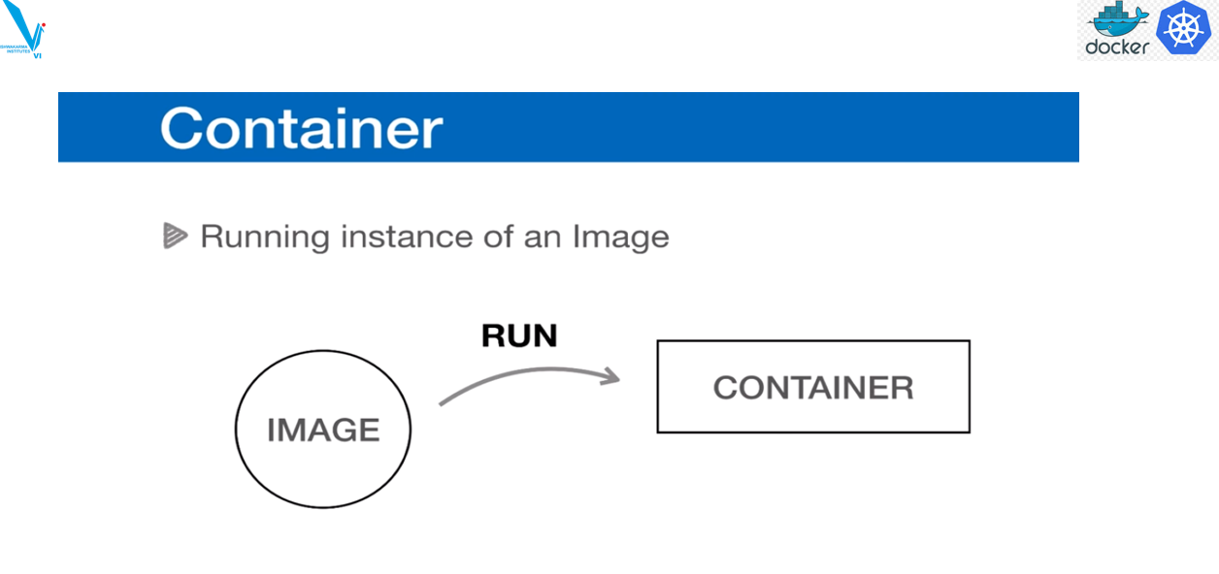

Slide 12

1. Three Tier web application using docker
1.get files from github link
javahometech/docker-compose-3-tier (github.com)
2.download zip file extract it
3.In Visual studio save dockers-compose.yml file
4.Run cmds in power shell

Slide 13


docker-compose up -d

Slide 15

OUTPUT

